Slide 1
CPS | SPECIAL RISK SERVICES
NEW AGENT ONBOARDING
Working With CPS | Special Risk Services
A guide to contracting, underwriting, quoting, and getting paid — the way we actually do business together.
Presented by Tim Fuller · Senior Executive Vice President · tjfuller@srsinc.com
Notes:
Hey, welcome to the team. I'm Tim Fuller, Senior Executive Vice President here at CPS Special Risk Services, and this is a quick walkthrough of how we actually work together: contracting, underwriting, quoting, and getting paid. Let's get you up to speed.

Slide 2
CPS | SPECIAL RISK SERVICES
WHAT WE'LL COVER
Everything you need to start writing business with us
1
Contracting — fast & simple
6
Our website & agent tools
2
Underwriting 101 & shopping the case
7
Submitting an application
3
The Financial Life Cycle approach
8
Case status & communication
4
Asking for life insurance
9
Policy delivery & getting paid
5
Requesting a quote from us
10
Beyond life insurance
02
Notes:
Here's everything we're going to cover today, ten topics start to finish. We'll start with contracting, move into how we shop a case with our carriers, talk about the Financial Life Cycle approach I like to use with clients, how to ask for life insurance without it feeling like a sales pitch, how to get a quote from us, our website and agent tools, submitting an application, staying on top of case status, getting paid, and finally a quick look at the other products we offer beyond life insurance.

Slide 3
CPS | SPECIAL RISK SERVICES
HOW WE WORK TOGETHER
“We’re on the same team. If you get paid, I get paid.”
— Tim Fuller, on what “concierge-level service” means at SRS
1
2
3
Concierge-level service
One contact for everything
You will never bother us
We take on the tech, the underwriting legwork, and the back-office headaches so you can focus on the client.
Tim is your back office. Questions, quotes, tricky cases — call, text, or email instead of guessing.
Call anytime. If it’s urgent and you haven’t heard back in an hour or two, call the cell. We want you calling.
Notes:
Before we get into the mechanics, I want you to understand the philosophy behind all of it. We're on the same team, if you get paid, I get paid. That means we take on the underwriting legwork, the technology, and the back-office headaches so you can focus on the client in front of you. I'm your one point of contact for anything, questions, quotes, tricky cases, call, text, or email me instead of guessing. And I mean this: you will never bother us. If it's urgent and you haven't heard back in an hour or two, call my cell.

Slide 4
CPS | SPECIAL RISK SERVICES
STEP 1
Contracting — fast and simple
Most states are not pre-appointment states, which means we can submit your contracting the same day you submit your first application.
1
2
3
Complete the packet
We do the paperwork
You're ready to write
START YOUR CONTRACTING
Fill out the SRS contracting & appointment packet through DocuSign — it’s quick, guided, and e-signed.
We populate your information onto each carrier’s specific contracting forms for you.
Submit an application the same day — contracting and underwriting move in parallel in most states.
SRS Contracting Packet
One DocuSign packet gets your contracting started with us today.
What you'll need
• Current E&O policy, with every agent individually named on the declarations page
• A voided check for EFT commission payments (account name must match how you're contracted)
• AML training within the last 24 months (LIMRA preferred)
Open the Contracting Packet →
Or find it anytime under Tools → Contracting Commission at srsinc.com
04
Notes:
Let's start with step one: contracting. Most states aren't pre-appointment states, which means we can get your contracting moving the same day you submit your first application. Here's how it works: you complete one SRS contracting and appointment packet through DocuSign, quick, guided, e-signed. We take that and populate your information onto each carrier's own contracting forms for you. And because contracting and underwriting move in parallel in most states, you're ready to write business right away. You'll need three things: a current E and O policy with every agent individually named, a voided check for EFT commission payments, and AML training completed within the last 24 months. The link to start your contracting packet is right here, and you can always find it again under Tools, Contracting Commission, on our website.

Slide 5
CPS | SPECIAL RISK SERVICES
STEP 2
Underwriting 101 — shop the case, not just the client
Every carrier prices health and lifestyle differently. Guessing wrong costs your client money — and can cost you the sale.
40+
REAL EXAMPLE: TOBACCO USE
HOW WE SHOP A COMPLICATED CASE
36 of 40 carriers rate a tobacco-chewer at tobacco rates — roughly double the premium.
1
Send Tim the health questionnaire (no client name needed)
life insurance carriers in our portfolio
2
Tim summarizes and shops it to underwriters at the right carriers
4 carriers will still offer non-tobacco rates, even with a positive nicotine test.
Underwriters respond with tentative offers
Licensed in all 50 states, so we can help your clients wherever they live.
3
4
Tim gives you an accurate quote — before you apply
Field underwriting finds the 4 before you apply — not after a decline.
05
Notes:
Now, underwriting 101, and this is important. We work with more than 40 life insurance carriers, licensed in all 50 states, and every one of them prices health and lifestyle differently. Here's a real example: 36 of our 40 carriers will rate a tobacco chewer at full tobacco rates, that's roughly double the premium. But 4 carriers will still offer non-tobacco rates, even with a positive nicotine test. Knowing which 4 before you apply is the difference between a placed case and a decline. So here's how we shop a complicated case: send me the health questionnaire, no client name needed. I summarize it and shop it to underwriters at the right carriers. They respond with tentative offers, and I get back to you with an accurate quote, before you ever apply.

Slide 6
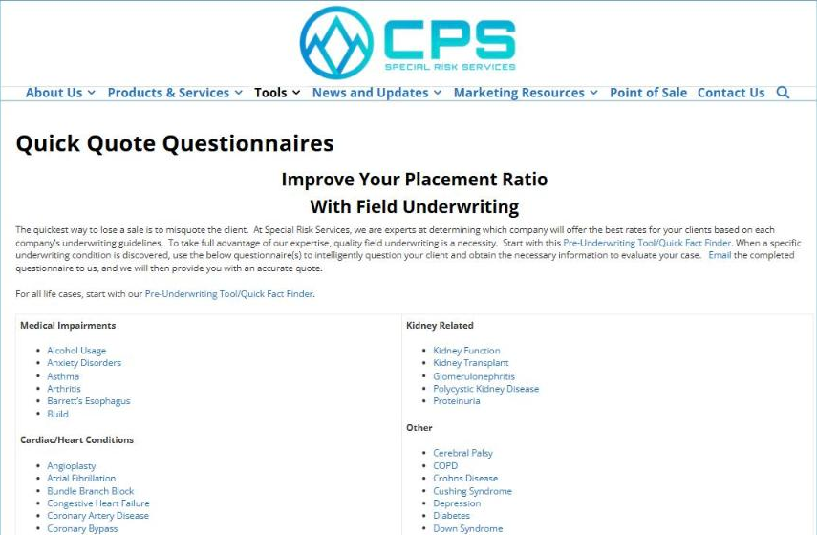
CPS | SPECIAL RISK SERVICES
FIELD UNDERWRITING
Health questionnaires, ready to go
“The quickest way to lose a sale is to misquote the client.”
We keep condition-specific quick-quote questionnaires — diabetes, cardiac history, cancer, sleep apnea, and dozens more — right on our website.
How to use them:
1. Ask your client the basics in a normal conversation.
2. If something complicated comes up, pull the matching questionnaire.
3. Email it to Tim — client details only, no name required.
4. Get back an accurate, shoppable quote.
srsinc.com → Tools → Underwriting Tools → Quick Quote Questionnaires
06
Notes:
The quickest way to lose a sale is to misquote the client, so we keep condition-specific quick-quote questionnaires right on our website: diabetes, cardiac history, cancer, sleep apnea, and dozens more. Here's how to use them: ask your client the basics in a normal conversation, and if something complicated comes up, pull the matching questionnaire and fill in the details. Email it to me, client details only, no name required, and I'll shop it and get you back an accurate, shoppable quote. You'll find all of these under Tools, Underwriting Tools, Quick Quote Questionnaires.

Slide 7
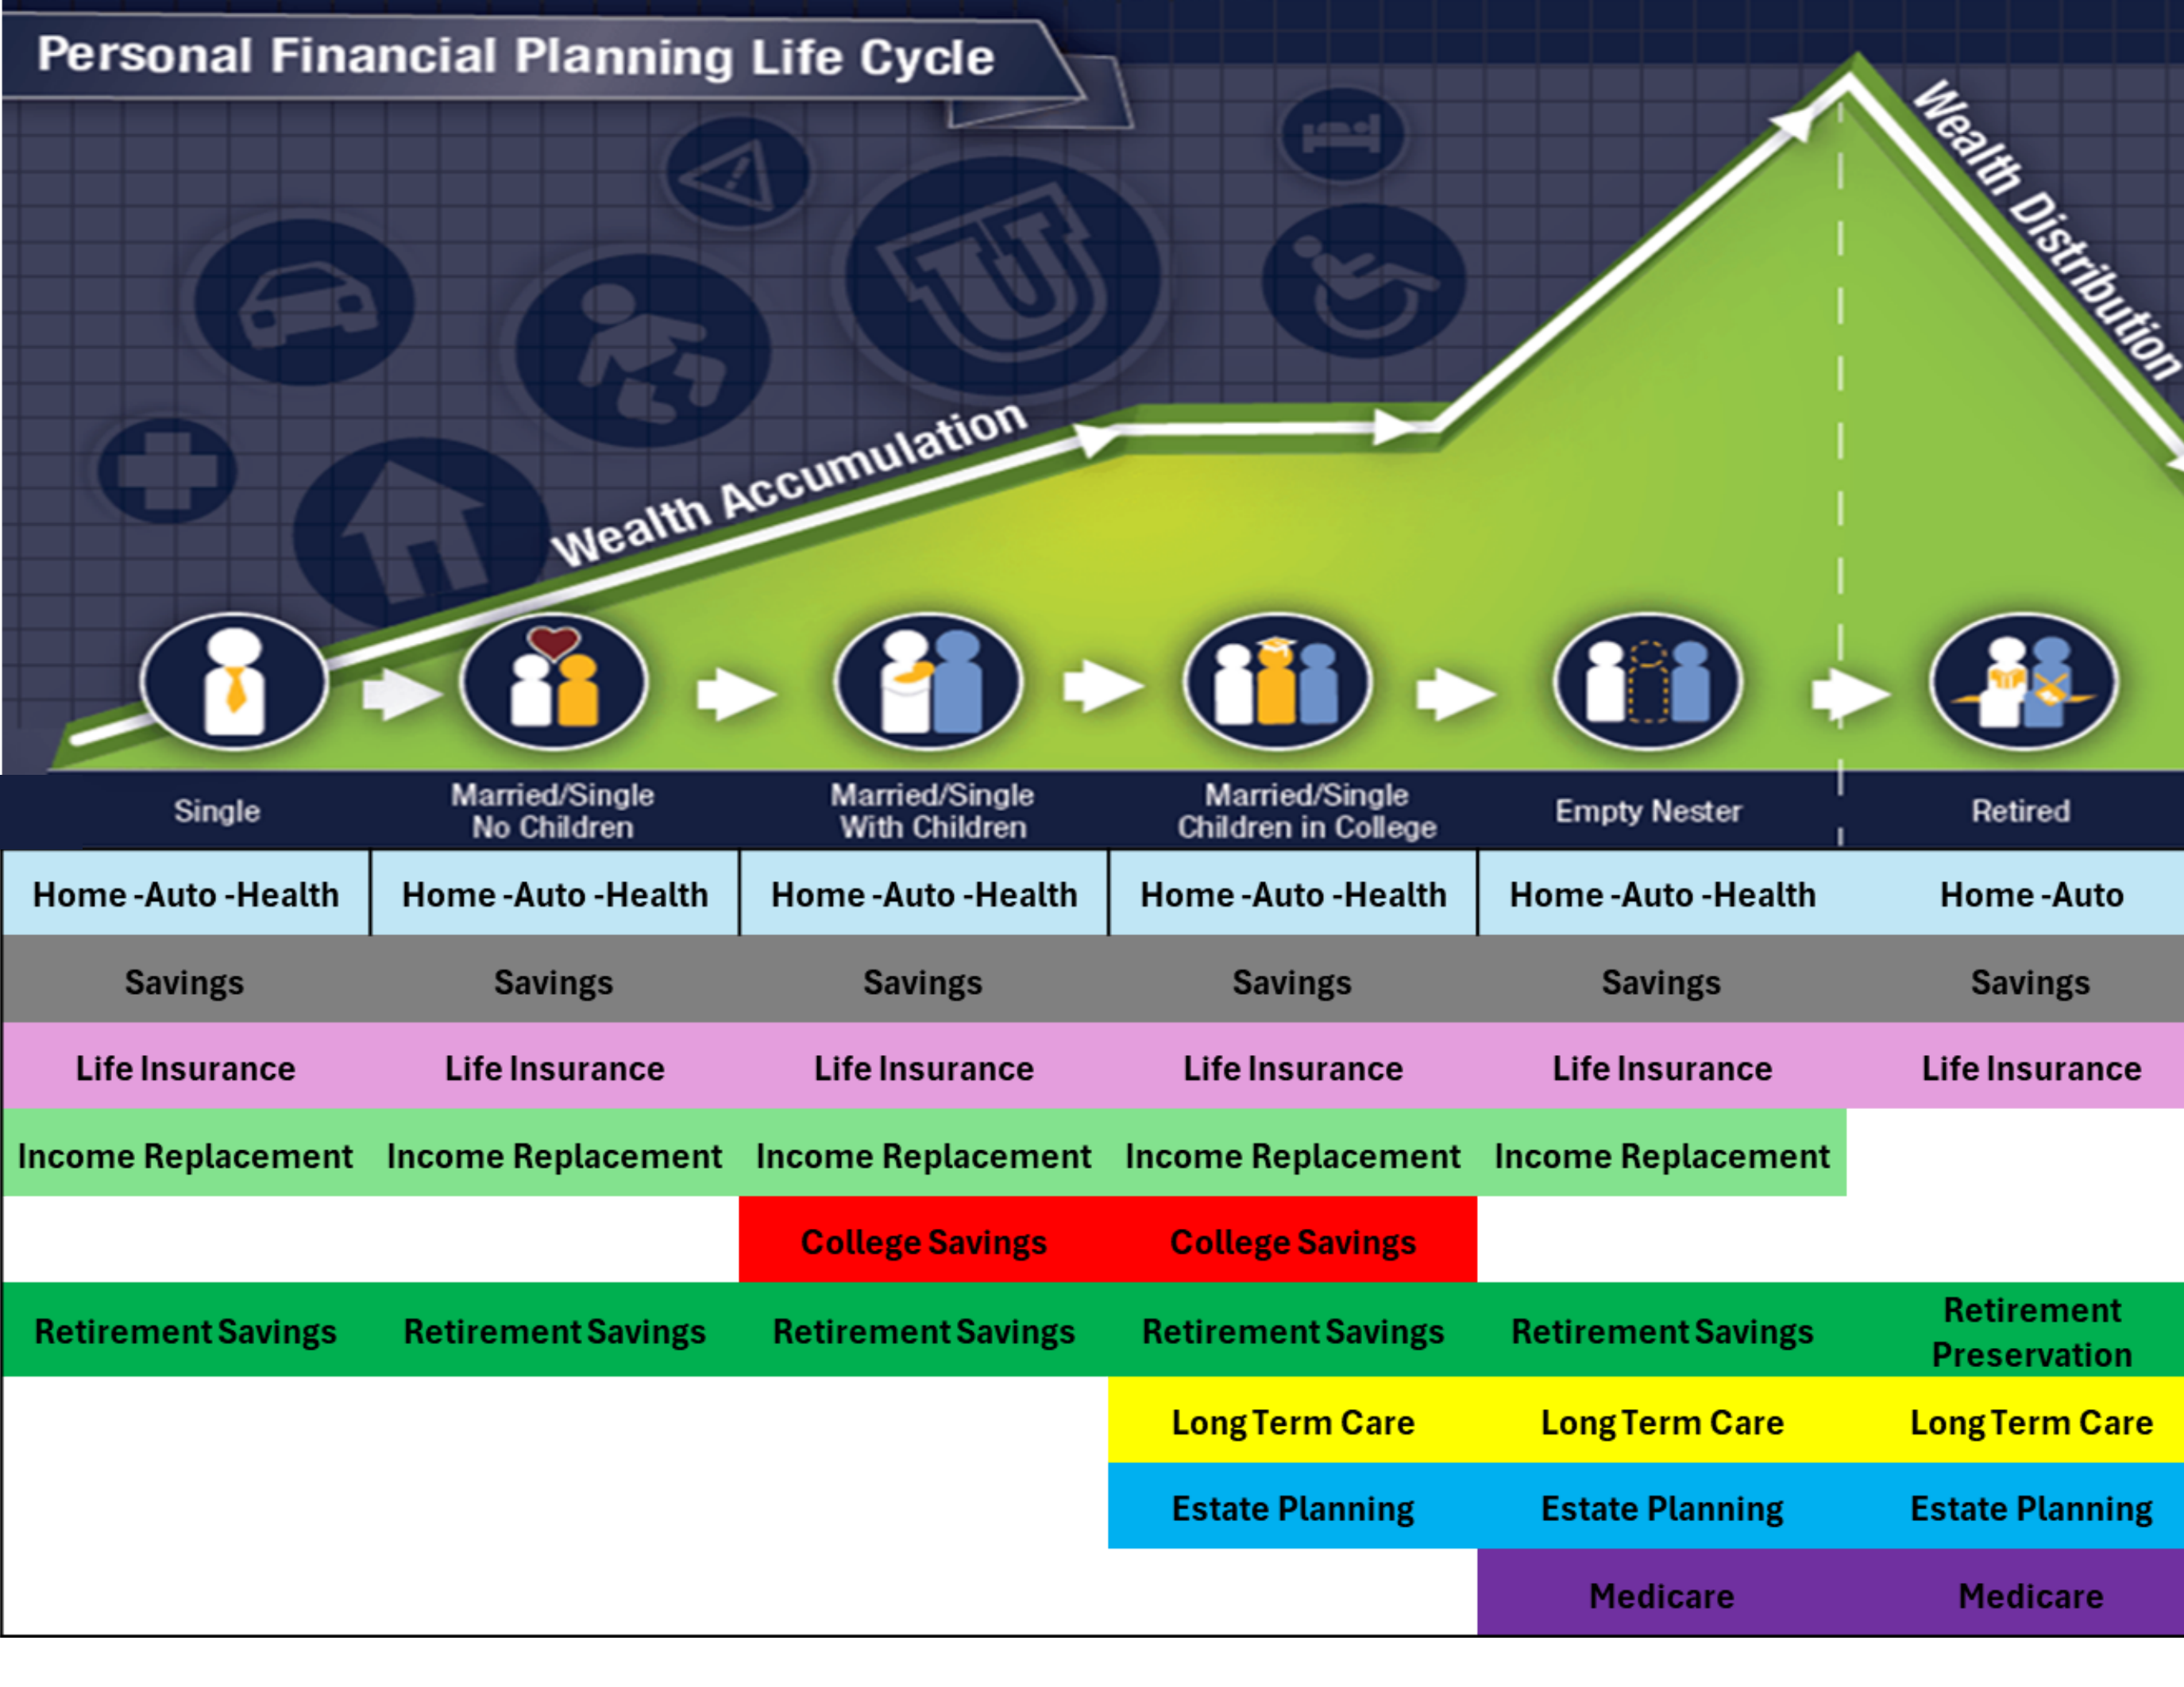
CPS | SPECIAL RISK SERVICES
TIM'S FAVORITE TOOL
The Financial Life Cycle
This is the single best visual for showing a client where their vulnerabilities are — and it opens the door to every product we offer, at the right moment.
07
Notes:
This next one is my favorite tool, and I use it in almost every client conversation: the Financial Life Cycle. It maps out a client's stage of life, single, married, kids, college, empty nester, retired, against the coverage that matters most at each stage: home, auto, health, savings, life insurance, income replacement, college savings, retirement savings, long-term care, estate planning, and Medicare. It shows a client exactly where their vulnerabilities are, without ever feeling like a pitch. It's included in the full deck we sent along with this guide.

Slide 8
CPS | SPECIAL RISK SERVICES
THE SCRIPT
Asking for life insurance — the non-threatening way
Every question below gives you permission to show the client more solutions. None of them sound like a sales pitch.
1
Do you currently own life insurance? (If so — company, coverage, premium, cash value)
5
Would you like coverage that lasts past retirement? (Permission to discuss permanent insurance)
2
What's your household income? (Gauges how much coverage may be needed)
6
Would you like policies that build cash accumulation? (Permission to discuss whole life / IUL)
3
Do you have children, and what are their ages? (Opens the door to college-savings life insurance)
7
Would you like insurance that replaces your income if you're hurt or sick? (Gently opens disability insurance)
4
What age would you like to retire? (Helps size the right term length)
08
Notes:
So how do you actually bring up life insurance without it feeling like a sales pitch? Here are seven questions that do it naturally. Ask if they currently own life insurance, and if so, get the company, coverage, premium, and cash value. Ask about household income, to gauge how much coverage they might need. Ask if they have children and their ages, that opens the door to college-savings life insurance. Ask what age they'd like to retire, which helps size the right term length. Then ask if they'd like coverage that lasts past retirement, that's your permission to talk about permanent insurance. Ask if they'd like policies that build cash accumulation, that opens whole life or IUL. And finally, ask if they'd like insurance that replaces their income if they're hurt or sick, that gently opens the door to disability insurance.

Slide 9
CPS | SPECIAL RISK SERVICES
STEP 3
Requesting a quote from us
Call Tim or send an email — here's what he needs to get you an accurate number fast.
TERM QUOTES
PERMANENT QUOTES
• Date of birth
• State the policy owner lives in
• Health class you'd like us to quote
• Term length(s) and benefit amount(s)
• Date of birth
• State the policy owner lives in
• Health class you'd like us to quote
• Cash accumulation, or death benefit only?
• How long the death benefit should last
• Product type: UL, GUL, IUL, or Whole Life
09
Notes:
When you're ready for a quote, just call or email me, here's what I need to get you an accurate number fast. For term quotes: date of birth, the state the policy owner lives in, the health class you'd like quoted, and the term length and benefit amount. For permanent quotes, I need those same basics, plus whether it's cash accumulation or death benefit only, how long the death benefit should last, and the product type, UL, GUL, IUL, or whole life.

Slide 10

CPS | SPECIAL RISK SERVICES
YOUR HOME BASE
Our website & agent tools
You'll receive an email with instructions to create your login. From there, everything lives in one place.
1
Apps & Forms
New business & policy service forms, organized by carrier.
2
eApplications
iGo, drop-ticket, and fully underwritten e-app options.
3
My Business Portal
Real-time visibility into every pending case.
4
Contracting
Everything you need to get appointed with a new carrier.
srsinc.com
10
Notes:
Once you're contracted, you'll get an email with instructions to create your login at srsinc.com, and from there, everything you need lives in one place. Apps and Forms has new business and policy service forms organized by carrier. eApplications gives you iGo, drop-ticket, and fully underwritten e-app options. My Business Portal gives you real-time visibility into every pending case. And Contracting has everything you need to get appointed with a new carrier.

Slide 11
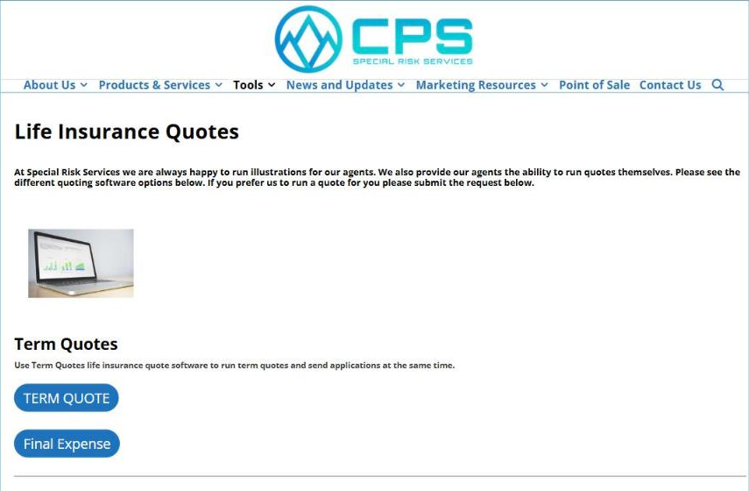
CPS | SPECIAL RISK SERVICES
SELF-SERVE
Running quotes yourself
Term quotes
Log in at srsinc.com → Tools → Life Insurance Quotes → Term Quote to run and compare rates across our carriers yourself, and send applications from the same screen.
Permanent quotes
We recommend letting us run these for you — there are more moving parts. Prefer to do it yourself? You also have access to WinFlexWeb.
srsinc.com → Tools → Life Insurance Quotes
11
Notes:
If you'd like to run quotes yourself, you can. For term quotes, log in, go to Tools, Life Insurance Quotes, Term Quote, you can compare rates across our carriers and send applications from the same screen. For permanent quotes, we actually recommend letting us run those for you, since there are more moving parts, but if you'd prefer to do it yourself, you also have access to WinFlexWeb.

Slide 12
CPS | SPECIAL RISK SERVICES
STEP 4
Submitting an application — the iGO e-App
Most of our carriers support e-applications through iPipeline's iGO platform — faster and cleaner than paper.
1
2
3
4
5
Go to srsinc.com
→
Tools → Forms & Applications
→
Click IGO Applications
→
Start New Case
→
Choose carrier & product
WHAT “IGO” MEANS
IGO stands for “In Good Order.” Every field highlighted in yellow still needs to be completed; it turns to a green checkmark once it's filled in correctly. The system won't let you submit until every field is green, so what lands on our desk is always complete.
Once you e-sign and submit, it comes straight to us — we start tracking it immediately.
12
Notes:
When you're ready to submit an application, most of our carriers support e-applications through iPipeline's iGO platform, it's faster and cleaner than paper. Here's the flow: go to srsinc.com, then Tools, Forms and Applications, click iGO Applications, start a new case, and choose the carrier and product. iGO stands for In Good Order, every field highlighted in yellow still needs to be completed, and it turns to a green checkmark once it's filled in correctly. The system won't let you submit until every field is green, so what lands on our desk is always complete. Once you e-sign and submit, it comes straight to us, and we start tracking it immediately.

Slide 13
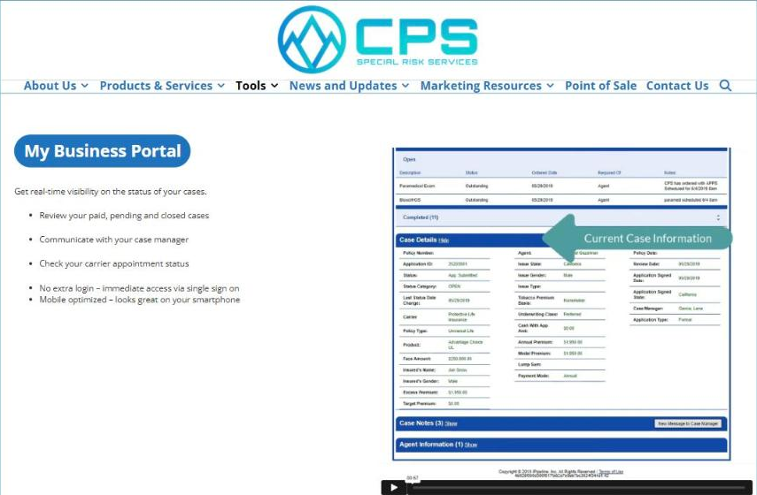
CPS | SPECIAL RISK SERVICES
STAYING IN THE LOOP
Case status & communication
Kim Fick, our Senior Case Manager, keeps every case moving and keeps you posted:
• Status-change emails as your case moves through underwriting
• A pending-cases report every Friday morning, automatically
• Real-time status anytime in My Business Portal
Haven't heard back in a day or two? Don't wait — call or email your case manager directly.
srsinc.com → Tools → My Business Portal
13
Notes:
Once a case is submitted, Kim Fick, our Senior Case Manager, keeps it moving and keeps you posted. You'll get status-change emails as the case moves through underwriting, a pending-cases report every Friday morning automatically, and real-time status any time in My Business Portal. And if you haven't heard back in a day or two, don't just wait, call or email your case manager directly.

Slide 14
CPS | SPECIAL RISK SERVICES
THE FINISH LINE
Policy delivery & getting paid
POLICY DELIVERY
GETTING PAID
Most carriers now support e-delivery — use it.
A paper policy adds 2–3 weeks to your cycle time. Once the policy is e-delivered, e-signed, and the client pays, it goes in force.
Carriers pay you directly.
We strongly recommend setting up EFT with each carrier. Track commissions on each carrier's own website.
We're not taking anything off your agent comp — SRS is paid an override on the back end.
14
Notes:
Let's talk about the finish line. Most carriers now support e-delivery, so use it, a paper policy adds two to three weeks to your cycle time. Once the policy is e-delivered, e-signed, and the client pays, it's in force. As for getting paid: carriers pay you directly, and we strongly recommend setting up EFT with each one. You can track your commissions on each carrier's own website. And to be clear, we're not taking anything off your agent comp. SRS is paid an override on the back end, so how we get paid is tied directly to your success.

Slide 15
CPS | SPECIAL RISK SERVICES
GROW WITH US
Beyond life insurance
Today was all about life insurance. When you're ready, we can set up a dedicated training session on any of these — you don't need to be the expert, we'll co-pilot with you.
1
2
3
4
Annuities
Disability Income
Long-Term Care
Medicare
Rob Stauch — rob@srsinc.com
Tom Nicols — tnicols@cpsinsurance.com
Matt Anderson — manderson@cpsinsurance.com
Ask Tim to connect you with our Medicare team
15
Notes:
Today was all about life insurance, but we wholesale several other lines too. When you're ready, we can set up a dedicated training session on any of these, you don't need to be the expert, we'll co-pilot with you. For annuities, reach out to Rob Stauch. For disability income, that's Tom Nicols. For long-term care, Matt Anderson. And for Medicare, just ask me and I'll connect you with our Medicare team.

Slide 16
CPS | SPECIAL RISK SERVICES
WE'RE HERE TO HELP
Welcome to the team.
We look forward to building a long relationship — count on superior service, quality products, and a family-owned business approach.
YOUR PRIMARY CONTACT
“You're never gonna bother us.”
Tim Fuller
Senior Executive Vice President
tjfuller@srsinc.com · 303-309-3471
srsinc.com · 6901 S Pierce St #300, Littleton, CO 80128
Call, text, or email — any time.
Notes:
That's the whole picture, welcome to the team. We look forward to building a long relationship with you, and you can count on superior service, quality products, and a family-owned business approach every step of the way. If you ever need anything, I'm your primary contact, call, text, or email, any time. And I mean it: you're never gonna bother us.

